Slide 1
01
Radiation
Treatment Machine Capacity Planning
Aaron Nishizawa
Hashir Afnan
Hasan Ashraf
Jack Sun
Notes:
Good evening everyone, My name is Jack and today I am accompanied by Aaron, Hasan, and Hashir. Our presentation will go over our analysis of the case study involving Cancer Care Ontario.

Slide 2
PRESENTATION AGENDA
01
GENERAL SUMMARY
04
PROBLEM DESCRIPTION
02
SOLUTION APPROACH
05
RECOMMENDATIONS
Notes:
The presentation we have prepared for you will be in the following order. I will take you through the general summary of recommendations. Hasan will explain the objective function, constraints and changing variables. Hashir will go over the nuances of this model and our approach to modelling this problem. And last but not least, Aaron will present our final business recommendations.

Slide 3
GENERAL SUMMARY
Focus on total deviation
Build more rooms in under utilized locations
Invest in new linac technology
Notes:
The general summary of our recommendations can basically be summed up in these three pints. First being a focus on Total deviation, we understand that under deviation is important in this case, but we believe that total deviation will result in a better conclusion, which Hashir will describe later on in the presentation. Our second recommendation is to build more rooms in underutilized locations, and third, we should invest in new linac technology to increase the number of patients we can help per machine, I will now hand it off to Hasan to talk about our problem description.

Slide 4
Problem Description
Strategies/Scenarios
Goal
Limitations
Notes:
Cancer Care Ontario (CCO) is an provincial government agency that leads multi year system planning of cancer treatment resources
The CCO faces a multifaceted problem in that they have to allocate of a limited number of linac machines to a limited number of rooms in facilities .
More specifically there are only 16 cancer centres in all of Ontario and only specific centres have spare rooms for new linac machines.
The RTCIS has also mandated that the only certain amount of linac machines can be used, more specfically maximum 4 in 2013, 3 in 2014, 5 in 2015, 2 in 2016 and 2 in 2017. These are limitations on capacity .
What also needs to be noted is that demand in the upcoming years for CCO are to expected to increase 0.5% each year.
The main goal therefore will be to try to determine total demand and capacity with the limitations given and and then attempt to reduce the ratio of the people we are unable to help compared to the number of people we can help but do not need it.
I will now pass it on to Hashir who will give a more technical explanation on how we will acheive this goal.

Slide 5
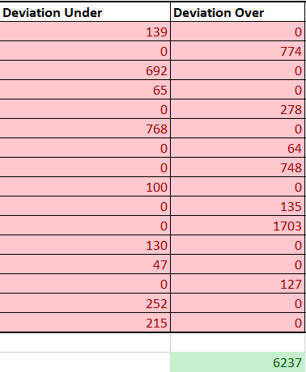
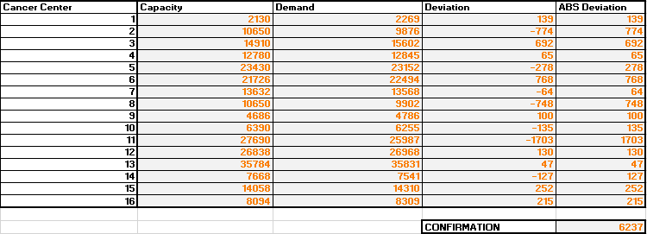
Solution Approach
Goal
Reduce Deviation between Capacity and Demand

Slide 6
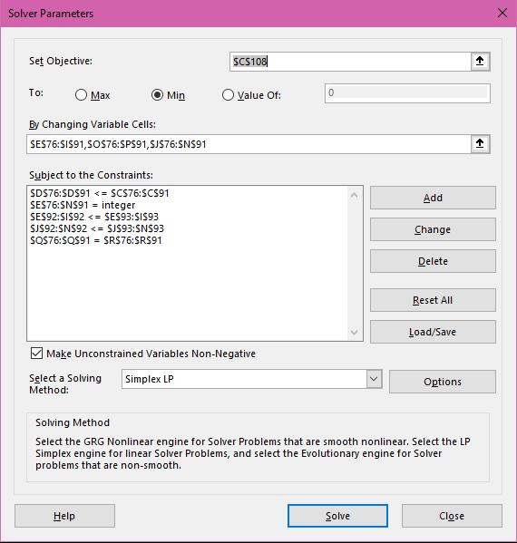
Solution Approach
Restrictions
Only specific centers have spare rooms available (Maximum 16)
Only certain amounts of Linac machines have been authorized
( 4-2013, 3- 2014, 5- 2015, 2- 2016, 2- 2017)
All Objective cells must be integers
To calculate deviance we must find the under and over capacity per center

Slide 7
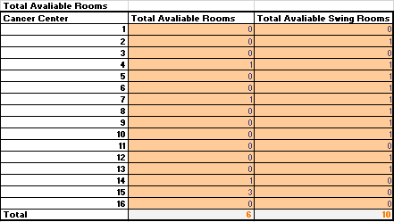
Solution Approach
Assumptions
Swing Rooms and Empty Rooms are the same
Linac machines are not being replaced at end of the 9 year life span

Slide 8
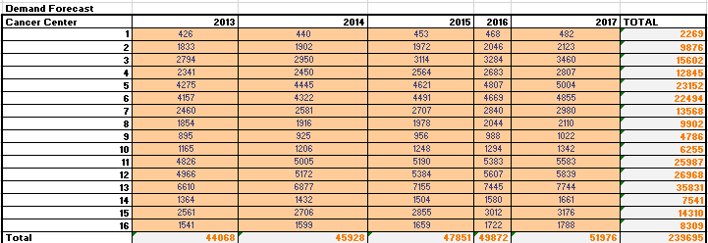
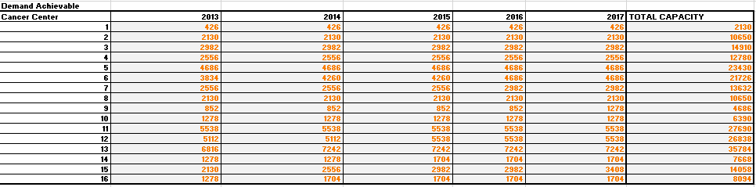
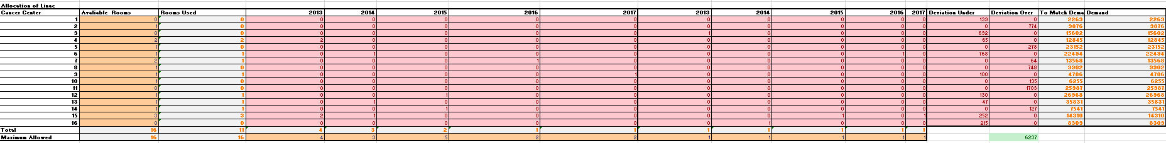
Solution Approach
Steps
Find Total Demand
Find Total Capacity in ideal conditions using solver and taking restrictions and assumptions into considerations
Find the Deviation between Demand and Capacity

Slide 9
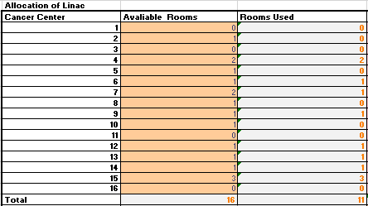
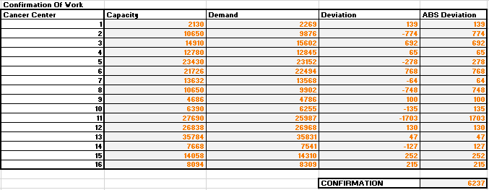
Solution Approach
Solution
Only 11/16 rooms need to be used
Linac Restriction is met in 2013 and 2014. However only ⅖ in 2015, ½ in 2016 and ½ in 2017.
Portable Linac is used every year to reduce total deviation from roughly 12700 to 6237
In total we the combination of under (# People we are unable to help) and over (# People we can help but don’t need it) is minimized to 6237

Slide 10
RECOMMENDATIONS
PORTABILITY
Invest in portable units as opposed to stationary
REFURBISHED MACHINES
Stretch funding dollars
BENEFIT
+1 portable unit will allow 2599 more patients to be treated from 2013-2017
BENEFIT
Spend less money on machines & allocate spending on infrastructure
30%-70% of original cost of a new LINAC machine
Refurbished machines require specialized software to run optimally
+1 = 42%
deviation
Notes:
https://www.slideshare.net/TopanArdiansyah1/linacs-radiation-treatment-machine-syndicate-9-1
https://www.nsmedicaldevices.com/analysis/refurbished-linear-accelerators-ros/
https://news.cision.com/elekta/r/elekta-introduces-new-radiotherapy-solution-to-help-address-worldwide-cancer-burden,c3194187

Slide 11
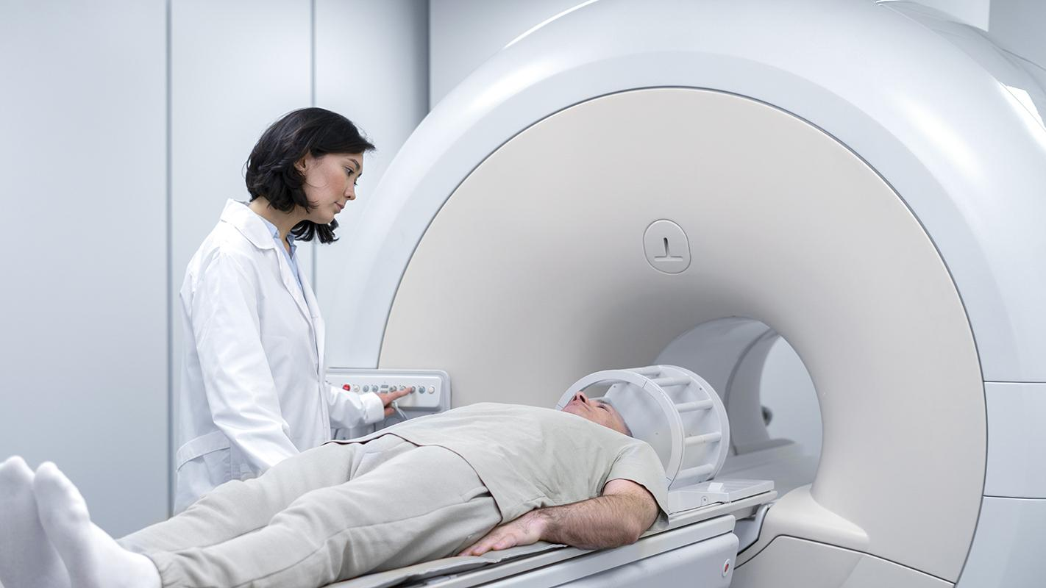
PRODUCTIVITY
Upgrading to a newer LINAC model to increase productivity
SOLUTION
Elekta introduces new radiotherapy solution to help address worldwide cancer burden
BENEFIT
Reduce setup time by
50%

Slide 12
QUESTIONS
01

